Slide 1
Steam Games Database
By Richard Edwards and Nevin Jom

Slide 2
System Description
Our project is a Database that consists of several games found on Steam, a popular game platform.
Users can browse for games, read or post reviews, like and wishlist games.
Users will have their own accounts which displays their liked, wishlisted and reviewed games.
Users can also check what games are currently on sale, and get notified via email if their wishlisted games go on sale.

Slide 3
Use-Case Diagram

Slide 4
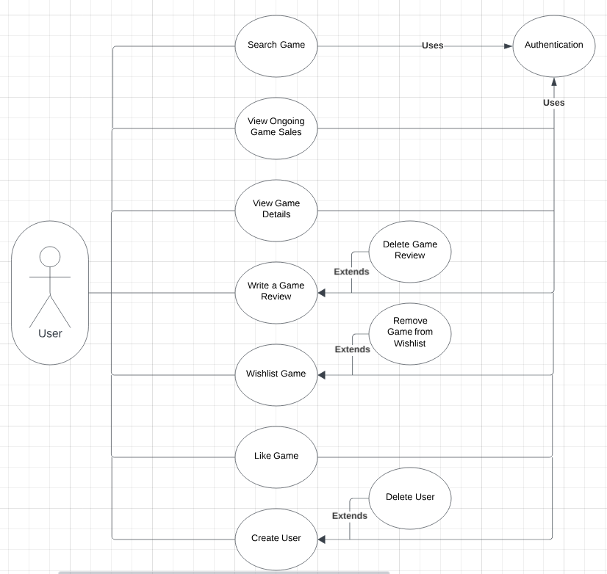

Slide 5
E/R Diagram and Schema

Slide 6
